Slide 1

ITEC113 Algorithms and Programming Techniques
Introduction to Programming

Slide 2
What is a computer
Computer
is a device that receives input, stores and processes data, and provides output in a useful format.
Computers process data according to sets of instructions called computer programs
Example: laptops, PCs, mainframes, even everyday objects such as mobile phones, washing-machines, TV sets, cars contain computers
Hardware
Physical components of a computer
Example: Keyboard, screen, mouse, disks, memory, CD-ROM, and processing units
Software
Programs that run on a computer
Example: Operating System such as windows XP -Vista -7, Word processing packages such as MS Word, registration program

Slide 3
Exercise : Distinguishing between input-process-output-storage
At the end of each month, a clerk enters the employee name, number of days present and absent, and the number of overtime done in the system. The system then calculates the normal salary, the amount for overtime and the total salary. The clerk then saves the information in the computer hard disk, and takes a backup on a cd. A report is produced for the clerk so that the latter can show to the manager.
Identify the following for that particular system
the employee name, number of days present and absent, the number of overtime
Input
Process(es)
Output
Storage
calculate normal income, calculate amount for overtime, calculate total salary
Report
Hard disk, CD
Notes:
referenceŞ http://wikieducator.org/User:Tzaynah/TComputingCourse

Slide 4
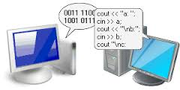
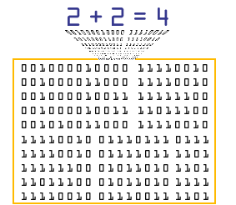
What is a computer?
Computers are NOT intelligent or telepathic
Computers do what we tell them to do they don’t do anything by themselves.
We must clearly tell a computer what to do in a step by step manner using a programming language.
Computers understand “electronic”
High voltage/low voltage
Machine language is binary (two values: high/low)
1’s and 0’s

Slide 5
Why are we using Computers?
Computers produce fast, accurate and reliable results.
While computers do the boring, repetitive, ordinary tasks, we can spend our efforts and time to work on more interesting and creative tasks.
The use of computers in business and manufacturing decreases the cost of goods and services produced.
It is more difficult and needs more time to find or grow up a skillful labor in IT industry, while buying an additional computer and installing the required software on is easier and cheaper.

Slide 6
Need for Programming
Computers are just electronic devices that have the power to perform difficult tasks but they do not ‘KNOW’ what to do.
Programmers tell the computers what to do by writing programs

Slide 7
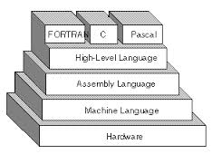
Types of Programming languages

Slide 8
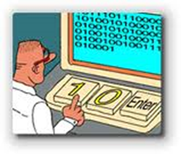
Three types of programming languages
1.Machine languages
Strings of numbers giving machine specific instructions
Example:
+1300042774
+1400593419
+1200274027

Slide 9
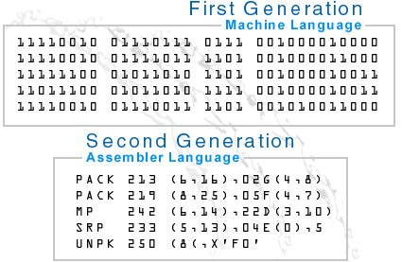
Types of Programming languages
Three types of programming languages (continued)
2. Assembly languages
English-like abbreviations representing elementary computer operations (translated via assemblers)
Example:
LOAD BASEPAY
ADD OVERPAY
STORE GROSSPAY

Slide 10
Types of Programming languages
Three types of programming languages (continued)
3. High-level languages
Codes similar to everyday English
Use mathematical notations (translated via compilers)
Example Code:
grossPay = basePay + overTimePay
Example high level languages: C, C++, Cobol, Java, Pascal (Delphi), Basic (Visual Basic) Fortran, SQL, T-SQL, C# …

Slide 11
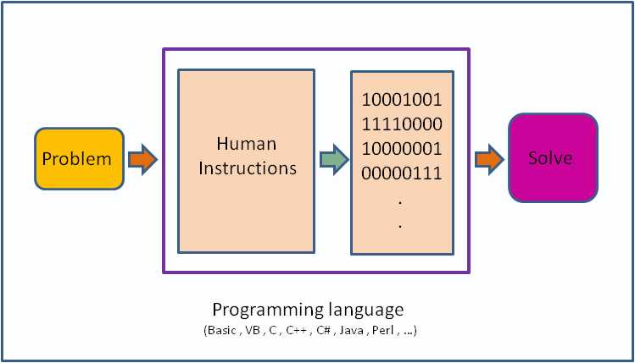
Use of programs to solve problems

Slide 12
What is Data, Information and Knowledge ?
Data are the raw facts, gathered from the environment which does not have much meaning.
Note: Data is plural, singular form is Datum.
Information is the end product of the processing of data, which has more meaning, and is used in decision making.
Knowledge is the proved and generalized form of information, that is used in strategic planning.
Notes:
Data is raw material for data processing. data relates to fact, event and transactions.
Information is data that has been processed in such a way as to be meaningful to the person who receives it. it is any thing that is communicated.
for example: researchers who conduct market research survey might ask member of the public to complete questionnaires about a product or a service. These completed questionnaires are data; they are processed and analyze in order to prepare a report on the survey. This resulting report is information. THAT'S ALL

Slide 13
What is Data, Information and Knowledge ?
DATA
INFORMATION
KNOWLEDGE

Slide 14
What is a Computer Program?
A computer program is
a set of instructions written in a computer language
executed to perform a specific task.
Also called SOFTWARE
There are tens of programming languages, used nowadays.
C, C++, C#, Pascal, Delphi, Visual Basic, Java, COBOL, FORTRAN, LISP, Prolog …

Slide 15
Who is a Programmer?
A programmer is a person
who writes the required computer programs.
Programmers translate the expected tasks
given in a form we can understand
into
a form machines can understand
Register students in EMU
Registration program written in Delphi

Slide 16
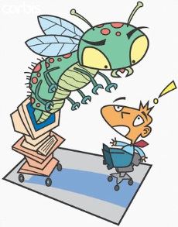
Types of Errors
Syntax Errors: Violation of syntactic rules in a Programming Language generates syntax errors.
Effect? Compiler helps user to identify the Syntax error and correct it
Semantic Errors: Doing logical mistakes causes semantic errors .
Effect? The Compiler can not notice these errors, but on execution, they cause unexpected wrong results. These errors can only be corrected by the careful programmer
Run-time Errors: Occur on program execution. Mostly caused by invalid data entry or tries to use not existing resources. ( E.g. Attempting to divide a number by 0 )
Effect? It occurs on run time and may crash the program execution.

Slide 17
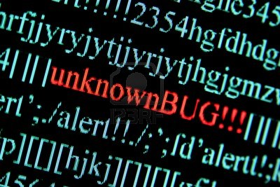

Slide 18
Properties of Well Designed Programs
Well designed programs must be:
Correct and accurate
Easy to understand
Easy to maintain and update
Efficient
Reliable
Flexible

Slide 19
Well designed programs must be
Correct and accurate
Easy to understand
Easy to maintain and update
Efficient
Reliable
Flexible

Slide 20
Steps involved in Programming
Requirement Specification:
Eliminate ambiguities
Clearly understand the problem
Analyze the problem :
Understand the inputs, outputs and processes used for manipulating the data, formulas and constraints
Design:
Write the algorithm (flowchart or pseudocode) to represent the solution
Testing and verification :
Check the algorithm.
Implement the algorithm :
Write a program
Testing and Verification:
Check the program
Documentation

Slide 21
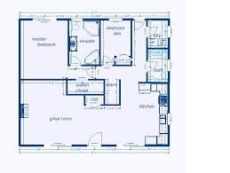
What is an Algorithm?
An algorithm is the plan for writing a program.
Steps required for solving a problem are listed by using an algorithm tool.
Algorithm tools make program solutions more clear, more understandable, and easier to remember.
Algorithms are written according to rules so that other programmers are also able to read and understand the solution easily.

Slide 22
Tools of Algorithms
There are many Algorithm tools in use, but the most popular ones are Pseudo-Codes and Flowcharts.
In this course for all problems we will use both of these tools but in general you choose only one.

Slide 23
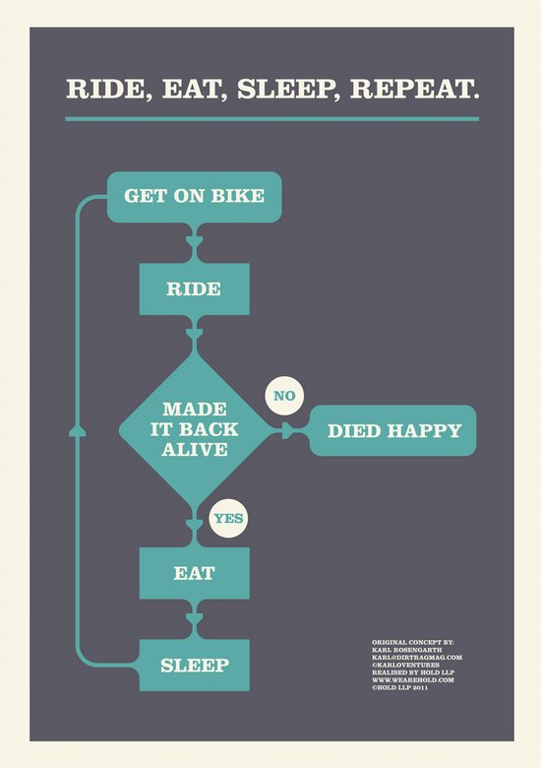
Biker’s Dream Life

Slide 24
Daily Routine of Students

Slide 25
Flowcharts
Flowcharts are graphical tools, containing a set of shapes, each expressing a different action in a sequence of program execution.
There are many different shapes that are used for specific purposes, to avoid complexity, in this course, only a limited subset of these shapes will be shown and used in applications.

Slide 26
Flowcharting Shapes
Every flowchart has to start with a TERMINAL shape containing the caption START and has to end with another TERMINAL shape containing the caption of END.
INPUT shape is used to indicate manual input or reading values from keyboard.
OUTPUT shape is used to indicate producing printed output to the user.
DISPLAY shape is used to indicate that a value is sent to the monitor.
Start
End
Student Id
Student Transcript
cgpa

Slide 27
Flowcharting Shapes
PROCESS shape is used to represent assignments and manipulations of data such as arithmetic operations.
DECISION shape represents the comparison of two values. Alternating course of actions is followed depending on the result of the criteria.
CONNECTOR symbol is used to show the connections of two pages, when your design occupies more then one page. Also used to collect together flow lines of decision shape.
FLOWLINE symbol is used to show the direction of the program flow between other symbols.
Num ←3
cgpa > 2.00
A

Slide 28
Flowcharting Shapes

Slide 29
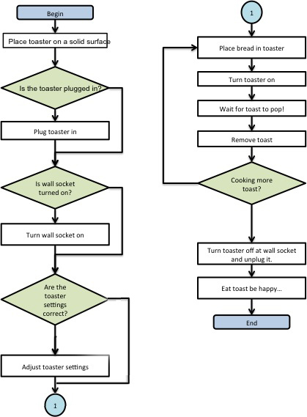
Use of Connectors
NO
YES
NO
YES
YES
NO
NO
YES

Slide 30
Pseudocode
Pseudocode is structured english that is used as an alternative method to flowcharts for planning structured programs.
There are no general accepted standards for pseudocodes.
We will work with a form that has minimum number of rules and is essentially language-independent.
Pseudo-code instructions are written in English,
they can be easily understood and reviewed by users.
The only syntax rules to be concerned with involve the LOOP and SELECTION structures.
They must be used as CAPITALISED words.

Slide 31
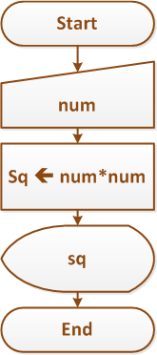
Exercises1
1- Write an algorithm that will ask user to input a number then your design will calculate and display the square of ınput number:
S1) Input num
S2) sq←num*num
S3) Display sq

Slide 32
Exercises2
2- Write an algorithm that will ask user to input height in meters then your design will convert and display the cm value of input number:
S1) Input meter
S2) cm←meter*100
S3) Display cm

Slide 33
References
CPIT/CSIT113 Lecture Notes, Mustafa Tuncel, Akile Yuvka, Yesim Kapsil
Yuksel Uckan, Problem Solving Using C,Structured Programming Techniques, McGraw-Hill
Deitel and Deitel, C: How to Program, McGraw-Hill

